Slide 1
Chunk-based Decoder for Neural Machine Translation
AI Lab
Lim Yeong Su

Slide 2
Neural Machine Translation
Introduction
Preliminaries
Model
Encoder
Vector Presentation
Decoder
Source Sentence
Target Sentence
Experiments
Conclusion
RNN
∵ Difficulty in capturing the structure of a target sentence that is unseen during translation

Slide 3
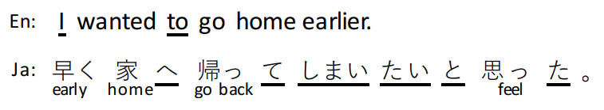
Problems of Sequential Decoder
Introduction
Difficult to model long-distance dependencies
Preliminaries
Multiple possible word orders
Model
Experiments
Conclusion
∴ 단순히 word order memorizing 하는 것은 정확한 번역을 하기에 충분하지 않다

Slide 4
Neural Machine Translation
Introduction
Preliminaries
Model
Encoder
Vector Presentation
Decoder
Source Sentence
Target Sentence
Experiments
Conclusion
CNN LSTM GRU Tree-LSTM
RNN
(LSTM, GRU)

Slide 5
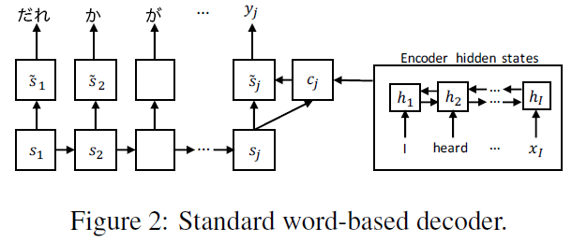
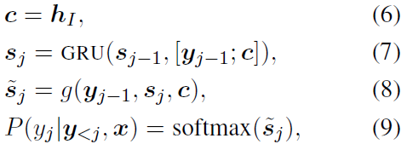
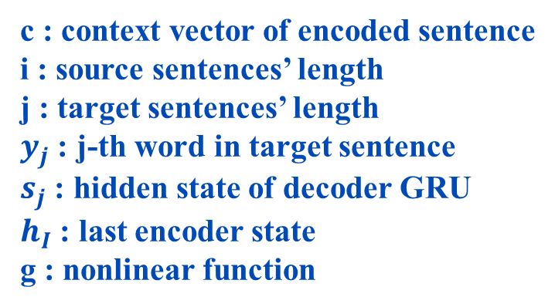
Neural Machine Translation
Introduction
GRU
Preliminaries
Model
Experiments
c : context vector of encoded sentence
i : source sentences’ length
j : target sentences’ length
$y_{j}$ : j-th word in target sentence
$s_{j}$ : hidden state of decoder GRU
$h_{I}$ : last encoder state
g : nonlinear function
Conclusion

Slide 6
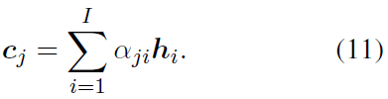
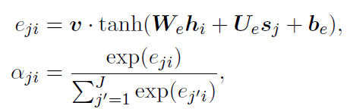
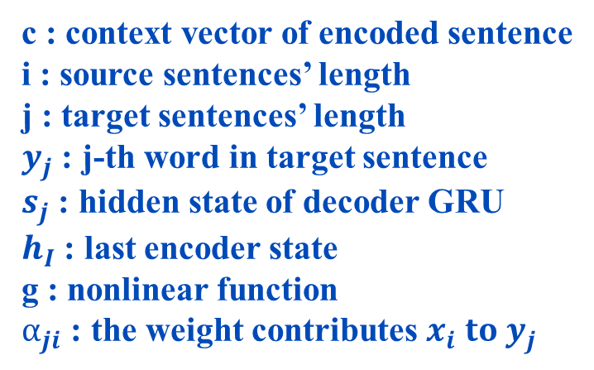
Attention Mechanism for Neural Machine Translation
Introduction
GRU
Preliminaries
Model
Use SGD with ADADELTA to train encoder & decoder GRU
Experiments
To use all hidden states of encoder!
c : context vector of encoded sentence
i : source sentences’ length
j : target sentences’ length
$y_{j}$ : j-th word in target sentence
$s_{j}$ : hidden state of decoder GRU
$h_{I}$ : last encoder state
g : nonlinear function
$α_{ji}$ : the weight contributes $x_{i} to y_{j}$
Conclusion
Computed by a feedforward network

Slide 7
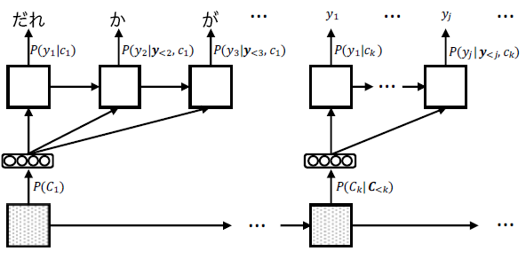

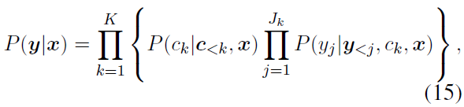
Chunk-based Decoder
Introduction
Chunk : 말뭉치
Preliminaries
-The word order in a chunk is almost always fixed.
-A chunk consists of a few content words
surrounded by zero or more function words.
Model
Experiments
Conclusion

Slide 8
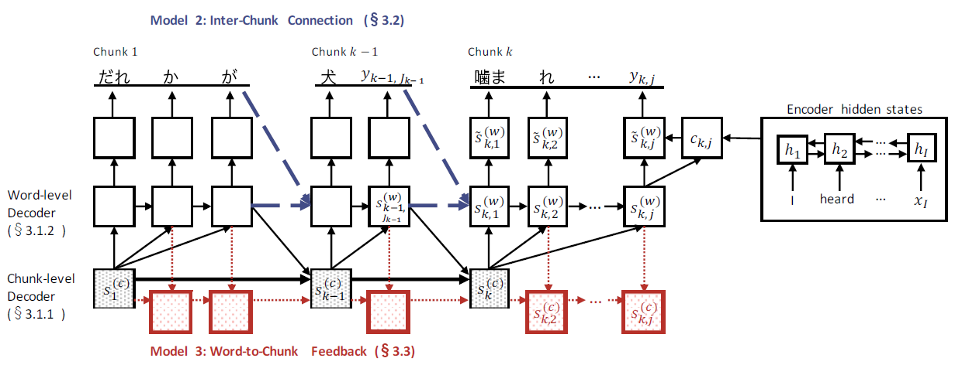
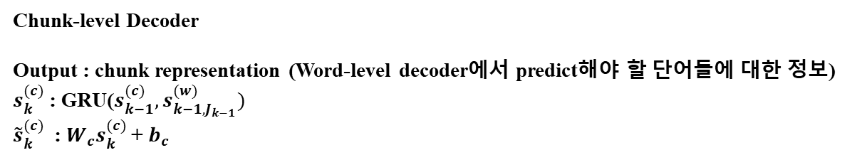
Model Learning
Introduction
Preliminaries
Model
Experiments
k : chunk의 개수
j : word의 개수
Conclusion
Chunk-level Decoder
Output : chunk representation (Word-level decoder에서 predict해야 할 단어들에 대한 정보)
$s_{k}^{(c)}$ : GRU($s_{k−1}^{(c)},s_{k−1,J_{k−1}}^{(w)})$
${\tilde{s}}_{k}^{(c)}$ : $W_{c}s_{k}^{(c)}$+ $b_{c}$

Slide 9
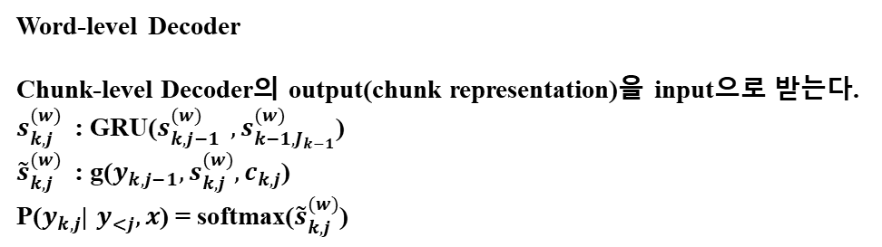
Model Learning
Introduction
Preliminaries
Model
Experiments
k : chunk의 개수
j : word의 개수
Conclusion
Word-level Decoder
Chunk-level Decoder의 output(chunk representation)을 input으로 받는다.
$s_{k,j }^{(w)}$ : GRU($s_{k,j−1 }^{(w)} ,s_{k−1,J_{k−1}}^{(w)}$)
${\tilde{s}}_{k,j }^{(w)}$ : g($y_{k,j−1},s_{k,j }^{(w)},c_{k,j}$)
P($y_{k,j}$| $y_{<j},x$) = softmax(${\tilde{s}}_{k,j }^{(w)}$)

Slide 10
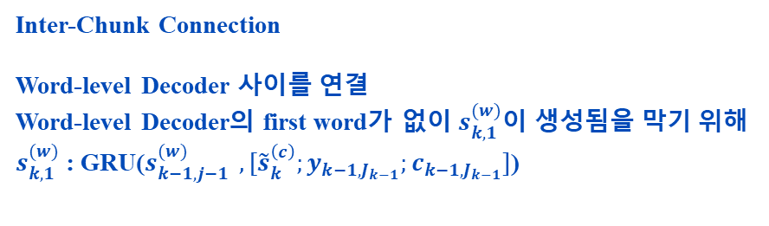
Model Learning
Introduction
Preliminaries
Model
Experiments
k : chunk의 개수
j : word의 개수
Conclusion
Inter-Chunk Connection
Word-level Decoder 사이를 연결
Word-level Decoder의 first word가 없이 $s_{k,1 }^{(w)}$이 생성됨을 막기 위해
$s_{k,1 }^{(w)}$ : GRU($s_{k−1,j−1 }^{(w)} ,[{\tilde{s}}_{k }^{\left(c\right)};y_{k−1,J_{k−1}};c_{k−1,J_{k−1}}]$)

Slide 11
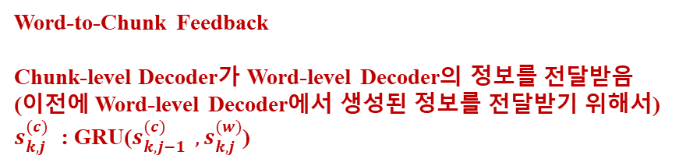
Model Learning
Introduction
Preliminaries
Model
Experiments
k : chunk의 개수
j : word의 개수
Conclusion
Word-to-Chunk Feedback
Chunk-level Decoder가 Word-level Decoder의 정보를 전달받음
(이전에 Word-level Decoder에서 생성된 정보를 전달받기 위해서)
$s_{k,j }^{(c)}$ : GRU($s_{k,j−1 }^{(c)} ,s_{k,j }^{(w)}$)

Slide 12
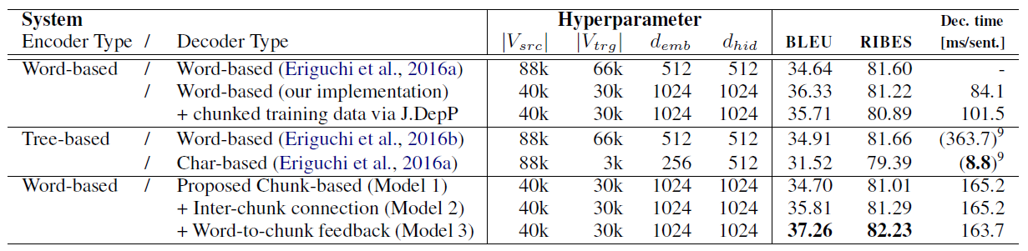
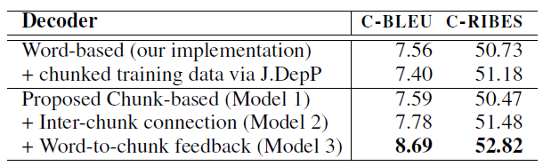
Results
Introduction
V : vocabulary size
d : dimension size
Preliminaries
Model
Experiments
Conclusion

Slide 13
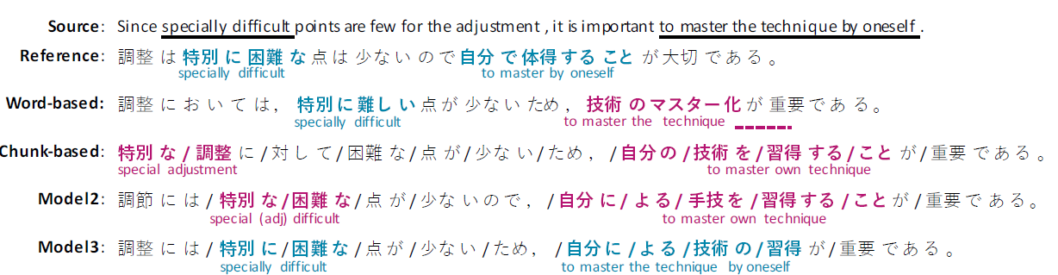
Results
Introduction
Preliminaries
Model
Experiments
Blue : correct
Red : wrong
Conclusion

Slide 14
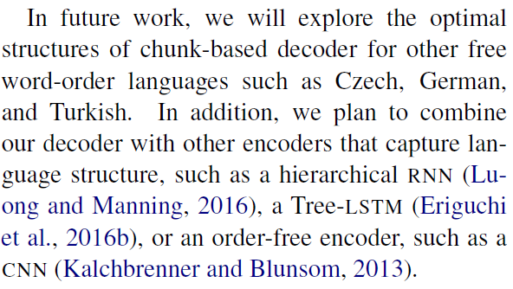
Future work
Introduction
Preliminaries
Model
Experiments
Conclusion
Related Work

Slide 15
Thank you

